Slide 1
Linear Regression: probabilistic view Linear Classification

Slide 2
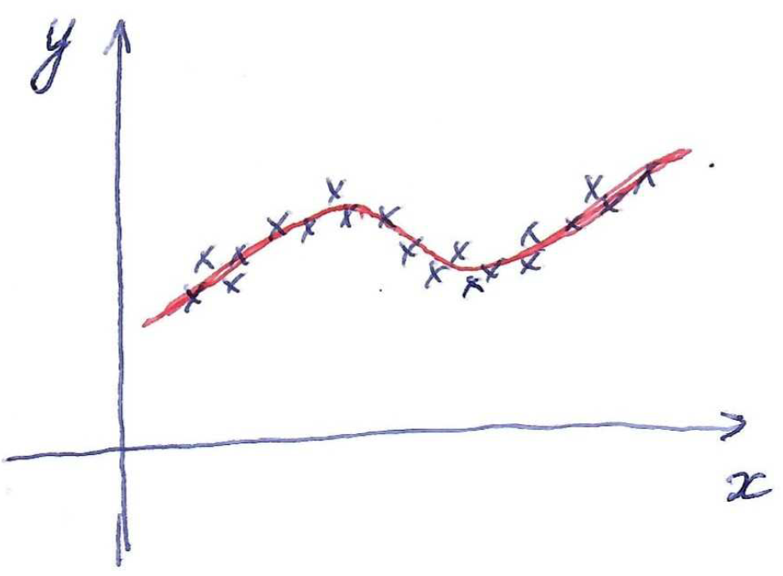
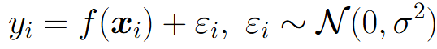
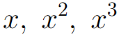
Linear regression
Good prediction model does not perfectly predict targets for training/testing objects (otherwise overfitting)
Let’s explain this inaccuracy with adding some random noise to prediction model:
Linear regression
with features
General idea: introduce some parametric probabilistic model of data generation, observe training data and find parameters of the model using e.g. maximum-likelihood estimation

Slide 3
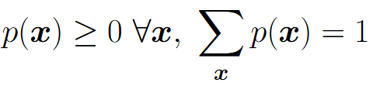
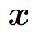
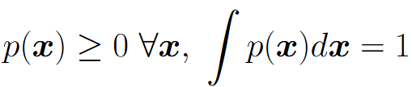
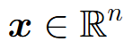
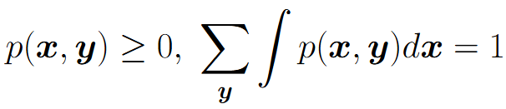
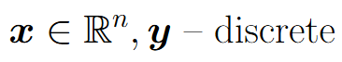
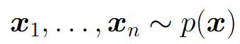
Probability distributions
Discrete variable :
Continuous variable :
Joint discrete-continuous case:
Basic operation - sampling from distribution:

Slide 4
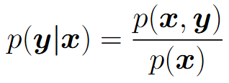
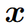
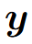
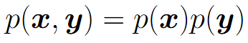
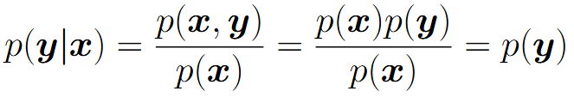
Conditional probability
In ML we’re interested in predicting one variable given another one. Hence conditional probability is useful:
Variables and are called independent if
For independent variables:

Slide 5
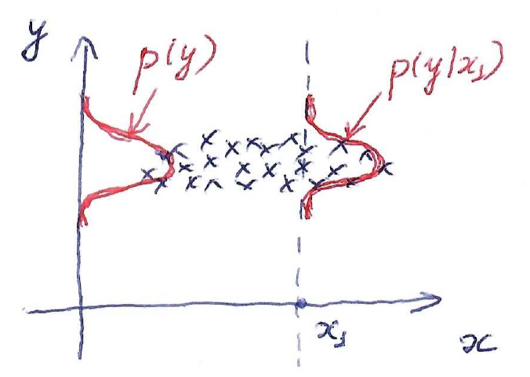
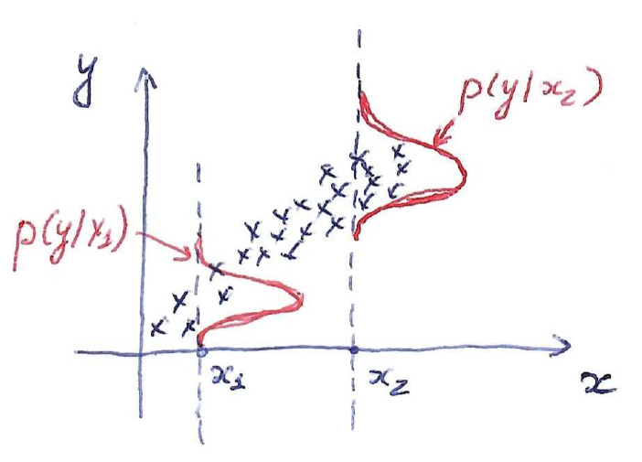
Conditional probability
Independent variables
Dependent variables

Slide 6
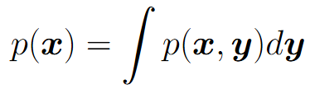
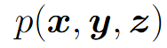
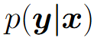
Operations with probabilities
Two basic operations: sum rule and product rule
Sum rule:
Product rule:
These two rules are enough to get from joint distribution to arbitrary marginal or conditional on subset of variables
Example: given find

Slide 7
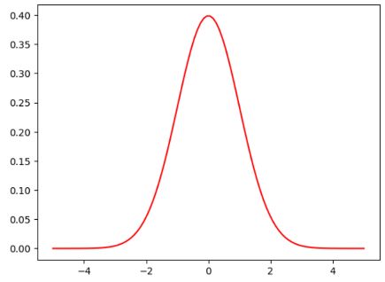
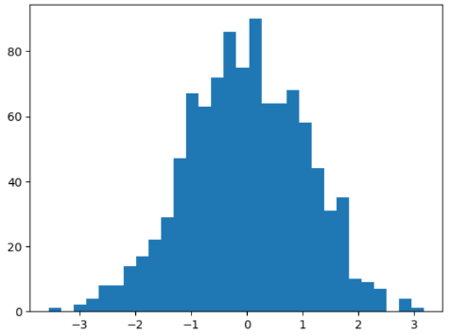
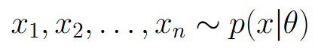
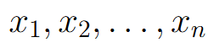


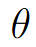
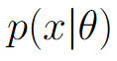
Distribution parameters estimation
Forward process: given probability distribution sample a set of points
Backward (estimation) process: given a set of points (data) estimate distribution parameters
Parameters of the prob. model

Slide 8
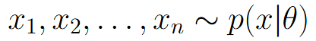
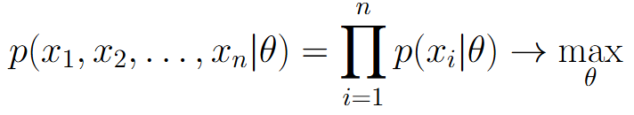
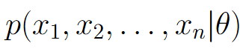
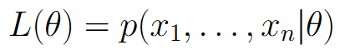
Maximum likelihood estimation
Suppose we have a set of points independently sampled from some parametric family of distributions
Goal: estimate parameters
Maximum likelihood (ML) estimation:
Terminology:
- as a function of x joint prob. distribution
- as a function of likelihood function
ML estimate has good theoretical properties for large n
(unbiased, consistent, efficient)

Slide 9
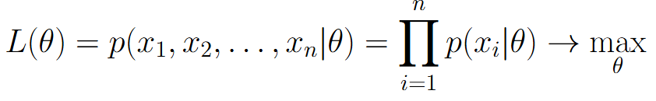
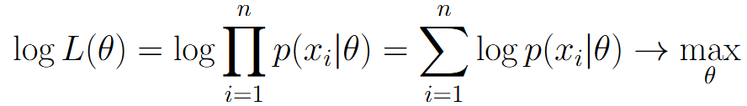
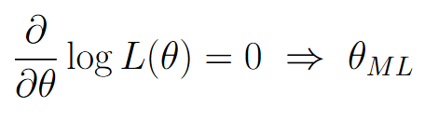
Maximum likelihood estimation
Maximum likelihood estimation:
Equivalent formulation:
Analytical solution:

Slide 10
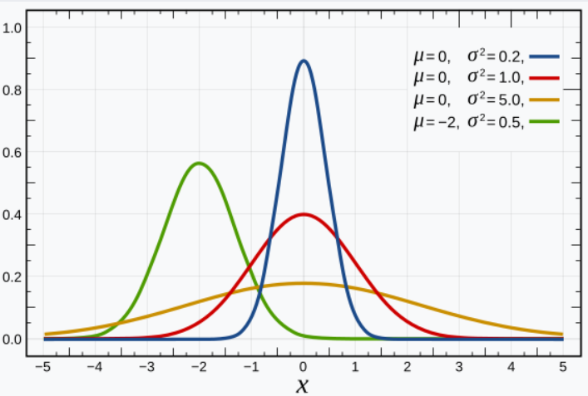
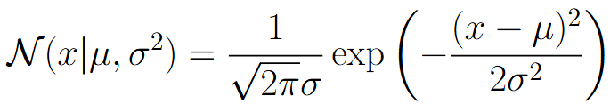
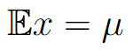
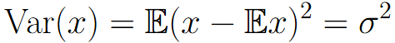
Normal distribution
Probability density function:
Statistics:

Slide 11
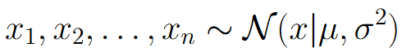
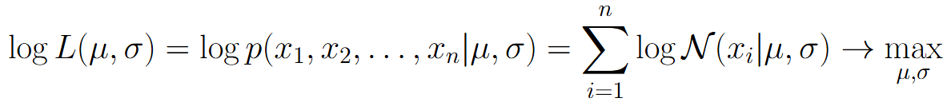
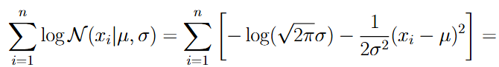
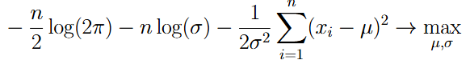
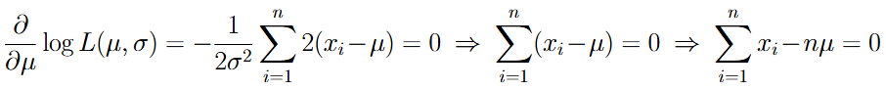
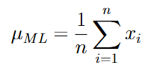
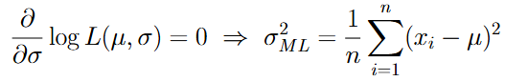
ML estimate for normal distribution

Slide 12
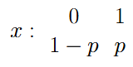
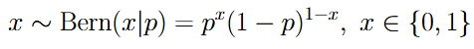
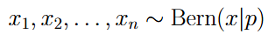
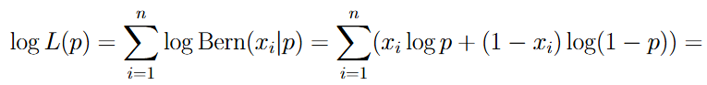
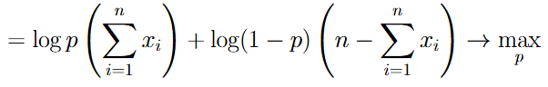
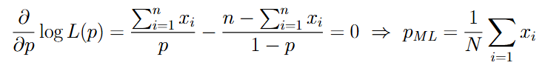
ML estimate for Bernoulli distribution

Slide 13









Linear Regression
Dataset:
ML-estimate for the model with normal noise = MSE loss minimization

Slide 14



Linear Regression
L1 loss

Slide 15





Linear Regression
Laplace distribution:
This optimization problem is equivalent to:

Slide 16



Probabilistic view for regularizer
MSE loss minimization view:
Equivalent probabilistic view:
ML estimate for parameters is equivalent to MSE loss minimization
MSE loss minimization + Regularizer:
Question: Can we find probabilistic analogue for L2-regularized MSE loss min.?

Slide 17







Bayesian Inference
Let’s encode our uncertain knowledge about some variable value in terms of probability distribution (prior distribution):
Make some measurement x that is indirectly connected with y:
Bayes formula:
Reestimate our uncertain knowledge about y after measurement x by finding posterior distribution:
Continue this process: make some new measurement z from , assume new prior and find new posterior
This is the same as making two measurements x, z, assume prior
and find posterior

Slide 18



Example: coin tossing (Bernoulli distribution)
Task: toss a coin (one or several times) and determine the probability of getting “head”
ML estimate:
Suppose we toss a coin only once, observe “head” =>
Can we get a more realistic estimation?

Slide 19





Example: coin tossing (Bernoulli distribution)
Uniform prior distribution:
Bayesian inference:
Bayesian estimate:
Suppose we toss a coin only once, observe “head” =>

Slide 20






Example: train delay estimation
Train delay in minutes:
Let’s assume Exponential probabilistic model:
Goal: estimate (delay model) using observations
Let’s take only one measurement x = 5. Then = 1/5 and we come to barely realistic green model of delays.
Common problem for ML estimates: they are weak for small sample size

Slide 21





Example: train delay estimation
Let’s apply Bayesian inference
Let’s assume some prior:
Observation model:
Bayesian inference:
Bayesian estimate:
Alternative:

Slide 22



Linear Regression: Bayesian view
Goal: estimate weights
Observation model:
Prior distribution:

Slide 23




Linear Regression: Bayesian view
The last optimization problem is equivalent to:

Slide 24
Linear Classification

Slide 25




Linear classification
Let’s consider two-class classification problem

Slide 26



Linear classification
Mean error rate
Regression
Classification

Slide 27



Linear classification
Mean error rate
Margin corresponds to distance from object to hyperplane = classifier confidence in prediction

Slide 28




Classification losses

Slide 29

Measuring classification quality
Accuracy is a reasonable metric for balanced classes in both training and testing set
Suppose we have some silly covid test that always says “person is healthy”. In dataset we have 950 healthy people and 50 sick people. Our covid test has 95% accuracy!

Slide 30
Measuring classification quality
Suppose we have two ML models for bank loans approval (scoring models). The first model approves 100 loans, among which 80 were returned and 20 were not returned. The second model approves 50 loans, among which 48 were returned and 2 were not returned. Which model is better?

Slide 31



Measuring classification quality
Confusion matrix
TP = True Positive
FP = False Positive
FN = False Negative
TN = True Negative
- How we can trust model in case of giving positive result
- How the model covers the positive class

Slide 32



Measuring classification quality
We need somehow combine precision and recall in one scalar criteria

Slide 33



Measuring classification quality
We need somehow combine precision and recall in one scalar criteria

Slide 34







Measuring classification quality
We need somehow combine precision and recall in one scalar criteria
If , then concentrates more on precision
If , then concentrates more on recall

Slide 35


Measuring classification quality
We need somehow combine precision and recall in one scalar criteria

Slide 36


Measuring classification accuracy
Suppose we have two ML models for bank loans approval (scoring models). The first model approves 100 loans, among which 80 were returned and 20 were not returned. The second model approves 50 loans, among which 48 were returned and 2 were not returned. The total amount of good loans in the dataset is 200. Which model is better in terms of F1?
First model:
Second model:

Slide 37


Changing precision/recall balance for particular linear classifier
High precision
Low recall
High recall
Low precision

Slide 38
Changing precision/recall balance for particular linear classifier
For fixed dataset we have only one linear classifier, that is determined by solution of the following optimization problem:
How can we get a classifier with different precision/recall characteristics?

Slide 39


Changing precision/recall balance for particular linear classifier
Let’s introduce some threshold in decision rule:
Let’s sort all objects in training set w.r.t. its score value:
High threshold corresponds to high precision and low recall
Low threshold corresponds to high recall and low precision

Slide 40






Measuring classification quality for all thresholds
We have introduced a family of classifiers:
How to characterize their quality for all thresholds simultaneously?

Slide 41


Precision-Recall Curve for ideal classifier
AUC-PRC = Area Under Precision-Recall Curve

Slide 42




Receiver-Operating Characteristics (ROC)
False Positive Rate
True Positive Rate

Slide 43




ROC for ideal and random classifiers
Ideal classifier:
Random classifier:
Ideal classifier
Random classifier
AUC-ROC = Area Under ROC Curve

Slide 44

Gini index
Gini index = 2 * AUC-ROC - 1
Gini index equals approximately 0 for random classifier and equals 1 for ideal classifier

Slide 45









AUC-PRC vs AUC-ROC
ROC is monotonic and always starts at (0,0) and ends at (1,1)
PRC is non-monotonic, starts at (0,1) and ends at point that depends on training set
Value of AUC-PRC is less sensitive to the case of unbalanced classes

Slide 46

Measuring quality for multi-class classification
Confusion matrix: for each pair of classes (y_i, y_j) compute number of cases when the true class is y_i and predicted class is y_j

Slide 47


Confusion matrix for MNIST
Object examples from the dataset:

Slide 48

Errors of linear classifier for MNIST
Visual inspection of errors with high confidence can be beneficial

Slide 49





Measuring quality for multi-class classification
For each class k let’s compute , where positive class is k-th class and negative class are all the rest.
Micro-averaging:
Macro-averaging:
Macro-averaging is better for unbalanced classes, but can be understated by one poorly predicted class.

Slide 50

Measuring quality for multi-class classification
Confusion matrix:
Micro-averaging:
Macro-averaging:

